Slide 1

Cryptography
Math is fun!

Slide 2
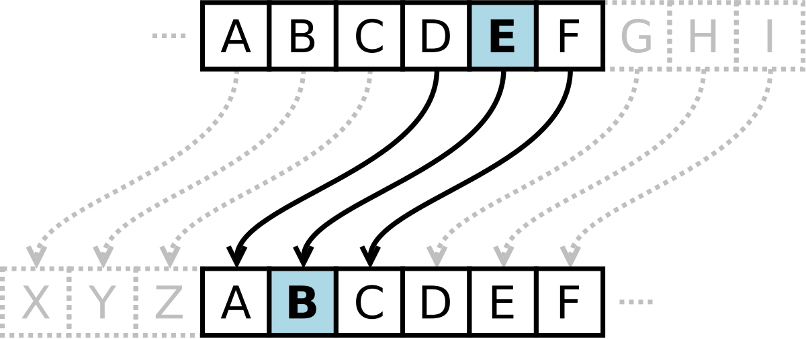
The Caesar Cipher
One of the earliest and most famous examples of cryptography is the Caesar cipher, named after Julius Caesar. He used it to protect messages of military significance.
The Caesar cipher is a type of substitution cipher where each letter in the plaintext is shifted a certain number of places down or up the alphabet. For example, with a shift of 3, 'A' would be encrypted as 'D', 'B' would become 'E', and so on.
It’s very simple by today's standards, and can be easily broken, but it was effective in an era when most people were illiterate and the concept of encrypted messages was novel.

Slide 3
Core conepts
Plaintext and Ciphertext, Encryption and Decryption, Symmetric Encryption, Asymmetric Encryption (Public Key Cryptography), Key Exchange, Hash Functions, Digital Signatures, Authentication, Salt, Cryptographic Protocol, Cryptanalysis, Side-Channel Attacks, Perfect Forward Secrecy (PFS), Zero-Knowledge Proofs, Block and Stream Ciphers, Cipher Modes, Nonce.

Slide 4
Hash
A hash function takes an input (or 'message') and returns a fixed-size string of bytes. The output, typically a digest, should be unique (within reason) for every different input.
It's computationally difficult (nearly impossible) to regenerate the original input from its hash output.
Examples: SHA-256, MD5 (though MD5 is considered insecure now).

Slide 5
digest
digest is the fixed-size output produced by a hash function when given an input. This output, the digest, should ideally be unique for every distinct input, making it a kind of "fingerprint" or "signature" for that input.

Slide 6
Digest options
'hex': This returns the hash as a hexadecimal string. Each byte of the hash is represented by two hexadecimal characters, so the output length in characters will be twice the byte length of the hash. For example, a SHA-256 hash will be 64 characters long in hex format.
'base64': This encodes the hash in Base64 format, which is a common encoding for transmitting binary data as ASCII strings. Base64 uses a set of 64 different characters to represent data. It's more compact than hex encoding: a SHA-256 hash will be 44 characters long in Base64 format (not including padding).
'latin1': This encoding will return a string where each character's code point in the string will be equal to the numeric byte value. It's less commonly used than 'hex' or 'base64' for cryptographic hashes.

Slide 7
Differences
Representation, Length
Usability: Hex and Base64 are more common for representing hashes, especially in contexts where the hash might be displayed or transmitted. Hex, in particular, is very common in cryptographic contexts because of its straightforward translation to bytes. Base64 is often used when there's a need to embed binary data in text, such as in URLs or email. Latin1 is less commonly used because it might not produce human-readable output.

Slide 8
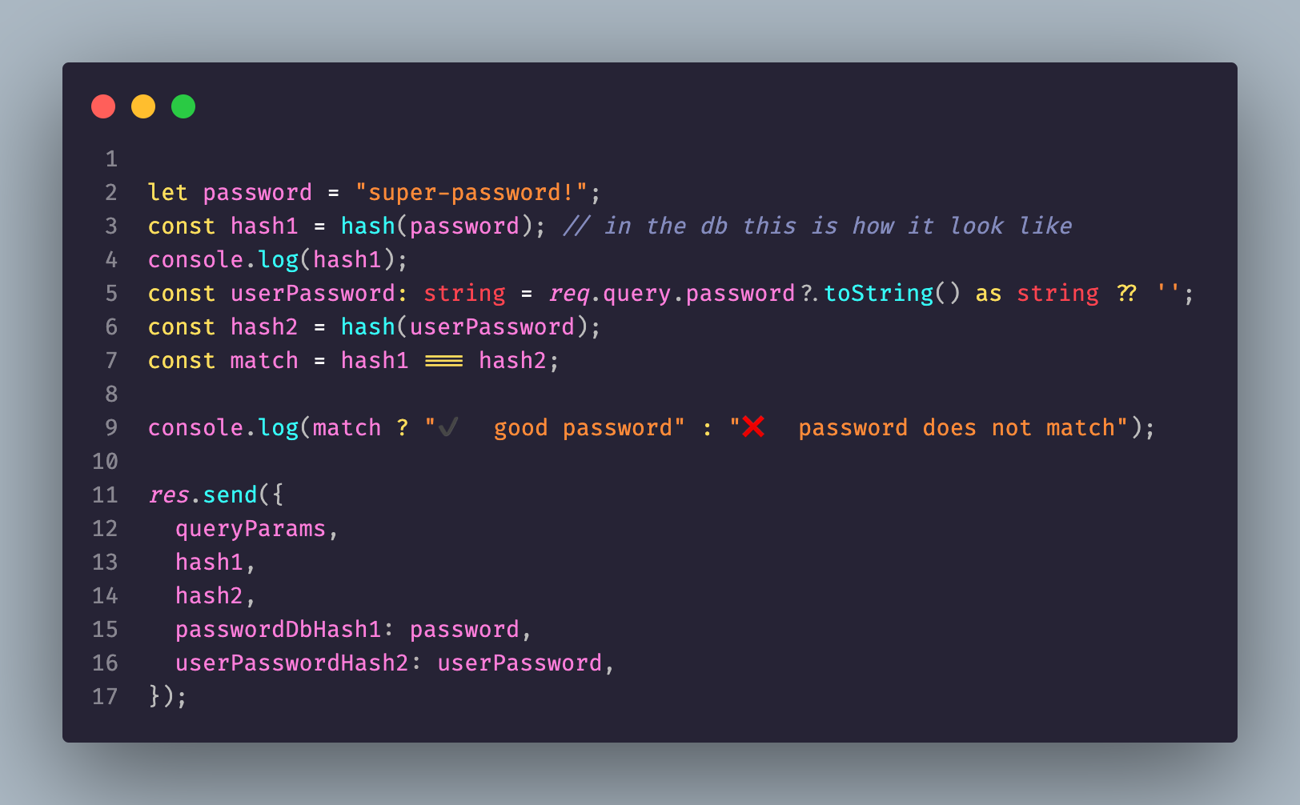
Example node
http://localhost:4000/crypto/hash/?password=super-password!

Slide 9

Salt - What is Salt?
A salt is a random sequence of characters that's used in conjunction with passwords during the hashing process. Its primary role is to ensure that even if multiple users have the same password, the hash of their passwords (when combined with the salt) will be unique.

Slide 10
Why Use Salts?
Defeating Rainbow Tables: Without salts, attackers can use "rainbow tables" — precomputed tables that map hashes to potential plaintext passwords. If passwords are hashed without a salt, an attacker can simply look up the hash in their table and potentially determine the plaintext password. With salts, this approach becomes unfeasible because the attacker would need a separate rainbow table for each possible salt value.

Slide 11
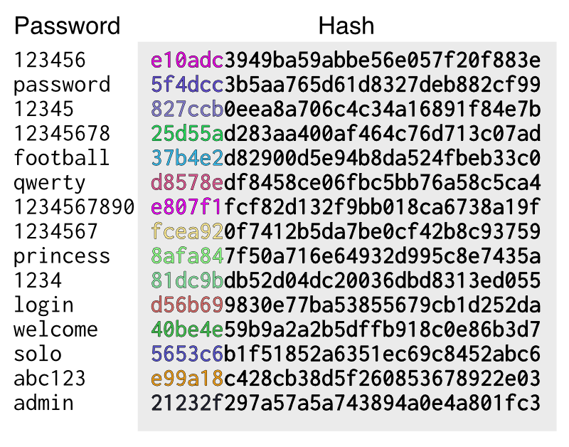
Rainbow table

Slide 12
Hash Collisions
Avoiding Hash Collisions: If two users have the same password, and if you hash those passwords without salts, you'll get identical hashes. This not only reveals that the two users have the same password but also makes attacks more efficient. Using different salts for each user ensures different hashes even if the actual passwords are the same.

Slide 13
Brute-Force Attacks
Slowing Down Brute-Force Attacks: For attackers who obtain a list of salted hashes, they can't precompute a lookup table for all possible passwords because of the unique salt for each password. They must compute the hash for each possible password + salt combination individually.

Slide 14
How to Use Salts Properly
Generation: Always use a cryptographically secure random method to generate salts. They should be random and sufficiently long to ensure uniqueness and unpredictability.
Unique for Every User and Password: Every password should have its own unique salt. Even if a user changes their password, a new salt should be generated.
Storing Salts: Salts aren't secret values. They are typically stored in the database alongside the corresponding password hash. This is necessary for the application to verify passwords on subsequent logins.
Combination: Before hashing, combine the password and salt. This can be done through simple concatenation, though some hashing algorithms have specific ways of incorporating salts.

Slide 15
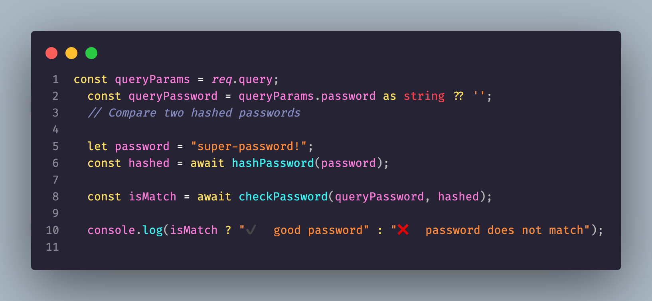
example
http://localhost:4000/crypto/salt/?password=super-password!

Slide 16
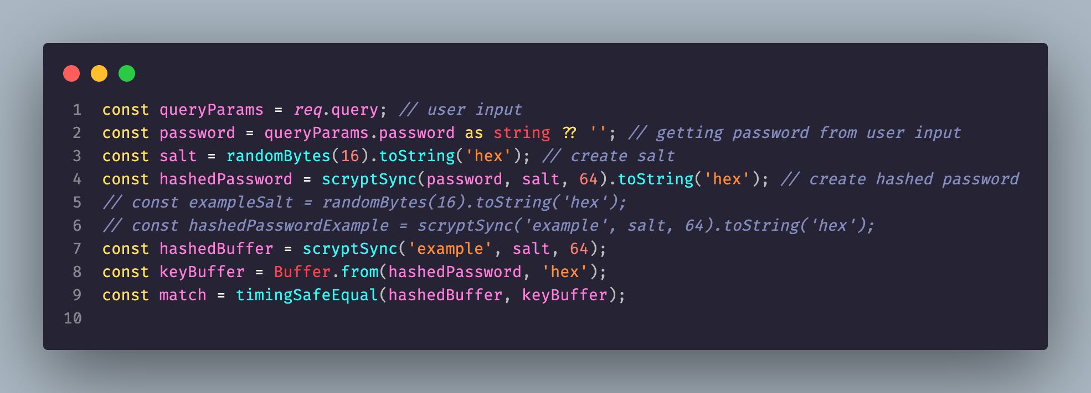
Example salt crypto
http://localhost:4000/crypto/saltCrypto/?password=example

Slide 17
Wait but what about the salt ?
One of the primary reasons to use a salt is to defend against rainbow table attacks. Rainbow tables are precomputed tables used to look up the hash of a plaintext string. By adding a unique salt to each password, you force an attacker to compute a rainbow table for each possible salt value, which is computationally infeasible for a sufficiently long salt.

Slide 18
HMAC
HMAC is a specific type of message authentication code (MAC) that uses a cryptographic hash function in combination with a secret key. It provides a way to check the integrity of information transferred between two parties, ensuring the message's integrity and authenticity.

Slide 19
Why Use HMAC?
Data Integrity: It ensures that the message hasn't been altered during transmission.
Authentication: It verifies that the message is sent by the claimed sender (authenticity).
Defends Against Attacks: Simple constructions, like just appending a key to a message and hashing it, can be vulnerable to certain cryptographic attacks like the length extension attack. HMAC is designed to be resistant to these.

Slide 20
How Does HMAC Work?
Inputs: HMAC takes three main inputs:
A secret key, K.
A message, M, that needs authentication.
A cryptographic hash function, H (e.g., SHA-256).

Slide 21
HMAC use cases
Data Integrity: Ensure data hasn't been altered during transfer.
Message Authentication: Verify the message's origin and integrity.
Web Security:
URL Signing: Protect URLs from tampering.
Webhooks: Authenticate callbacks from web services.
Password Storage: Derive and store password hashes with salts.
Challenge-Response Protocols: Use with cryptographic nonces.
Token Verification: Generate and verify tokens, e.g., JWTs.
Software Updates: Authenticate and ensure integrity of software patches.
API Security: Authenticate API requests using HMAC headers.
Network Packet Authentication: In VPNs and wireless networks.
Replay Attack Protection: Incorporate timestamps in HMAC'd data.

Slide 22

encryption
Encryption is a method of converting plaintext or any information into an unreadable format, known as ciphertext, to prevent unauthorized access. It's a fundamental concept in cryptography and is used to protect sensitive data frombeing accessed by malicious parties.

Slide 23
Basic Components
Plaintext: The original, readable information that you want to protect.
Ciphertext: The scrambled and unreadable output after encryption.
Encryption Key: A secret value used for encrypting the plaintext.
Decryption Key: A secret value used for decrypting the ciphertext back into plaintext. For symmetric encryption, the encryption and decryption keys are the same. For asymmetric encryption, they are different.

Slide 24

Types of Encryption
Symmetric Encryption
Asymmetric Encryption
Hybrid Encryption

Slide 25
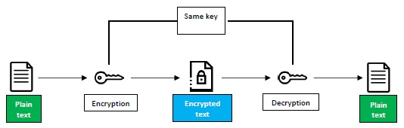
Symmetric Encryption
Uses the same key for both encryption and decryption.
Examples: AES, DES, and 3DES.
Faster than asymmetric encryption but requires both parties to securely share and manage the secret key.

Slide 26
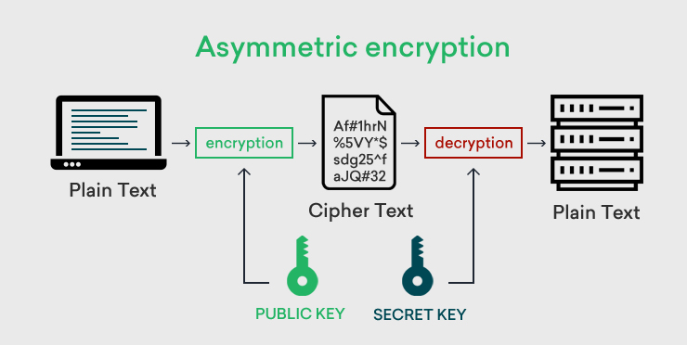
Asymmetric Encryption (or Public Key Cryptography)
Uses a pair of keys: a public key for encryption and a private key for decryption.
Examples: RSA, ECC.
More secure than symmetric encryption at the cost of being slower. No need to secretly share keys.

Slide 27

Hybrid Encryption
Combines the best of both symmetric and asymmetric encryption.
Typically, a symmetric key is used to encrypt data, and then this key is encrypted using asymmetric encryption and sent along with the data.
Commonly used in SSL/TLS for securing web traffic.

Slide 28
Use Cases
Secure Communication: Apps like WhatsApp use end-to-end encryption, ensuring only the sender and recipient can read messages.
Secure Storage: Encrypting sensitive data on storage devices.
E-commerce: Protecting financial transactions online.
Authentication: Digital signatures use encryption to verify the identity of a sender.

Slide 29
In Combination
In many real-world security protocols, encryption and HMAC are used together:
Encrypted communication ensures confidentiality.
HMAC ensures authenticity and integrity.
For instance, in the TLS protocol (used for HTTPS and other secure communications), both encryption (for data secrecy) and HMAC (for data integrity and authenticity) are often employed.

Slide 30
Summary
Encryption primarily ensures confidentiality but can be used for authentication through digital signatures in asymmetric encryption.
HMAC primarily ensures authenticity and integrity of data. It verifies that the data hasn't been tampered with and that it came from the expected sender.

Slide 31
Symmetric Encryption
Symmetric encryption is a type of encryption where the same key is used for both encryption (converting plaintext to ciphertext) and decryption (converting ciphertext back to plaintext). This means that both the sender and the recipient must possess the secret key and ensure that it remains confidential.

Slide 32
Props
Faster and less computationally intensive.

Slide 33
cons
Key distribution is a challenge. If the key is compromised, the security is broken.
Both sender and receiver must have the key and keep it secret.

Slide 35
Asymmetric Encryption
In asymmetric encryption, two keys are used: a public key (shared openly) and a private key (kept secret). Someone can encrypt a message using the recipient's public key, but only the recipient, with their private key, can decrypt it.

Slide 36

Props
Solves the key distribution problem. The public key can be openly shared without compromising security.

Slide 37
Cons:
Slower due to more computational work.

Slide 38

summary
Symmetric Encryption:
Encryption: Plaintext + Encryption Key = Ciphertext
Decryption: Ciphertext + Same Encryption Key = Plaintext
Asymmetric Encryption:
Encryption: Plaintext + Recipient's Public Key = Ciphertext
Decryption: Ciphertext + Recipient's Private Key = Plaintext

Slide 39

Key and IV
Key: Ensures that the data can only be decrypted by someone who knows the key. It's the "secret" in the encryption process.
IV: Makes sure that every encryption operation is unique, even if the same data and key are used. It provides unpredictability and prevents certain types of attacks.

Slide 40
How to encrypt your data?
Encrypting data on your AWS RDS (Relational Database Service) instance, if it's running SQL Server, PostgreSQL, MySQL, MariaDB, or Oracle, can be accomplished at several levels:

Slide 41
Encryption at Rest
AWS RDS Encryption: RDS supports encryption at rest using AWS Key Management Service (KMS). It encrypts your entire DB instance, which means it encrypts both your data and backups. To use RDS encryption:
Set up an encryption key in AWS KMS.
When creating a new RDS instance or when copying a snapshot, select the option for encryption and choose your KMS key.
Note: Existing RDS instances cannot be encrypted directly. If you want to encrypt an existing unencrypted DB, you'll need to create a snapshot, copy it with encryption, and then restore the encrypted copy to a new DB instance.

Slide 42
Encryption in Transit
SSL/TLS: Ensure that your applications connect to your RDS instance using SSL/TLS. Most databases supported by RDS offer SSL support for connections, ensuring data is encrypted in transit between the application and the DB.

Slide 43
Application-level Encryption
Encrypt Before Storing: You can use application-side libraries to encrypt sensitive data before saving it to the database. This is commonly used for especially sensitive data like credit card numbers, SSNs, etc.
AWS Encryption SDK: This SDK provides tools to help you encrypt and decrypt data within your application before sending or after retrieving it from the database.

Slide 44
Transparent Data Encryption (TDE) for SQL Server
If you're using SQL Server on RDS, you can use TDE, which is a built-in encryption method provided by SQL Server. TDE encrypts the storage of an entire database by using an encryption key called the database encryption key.
There is similar tools in other SQL flavors

Slide 45
Field-level Encryption
Some databases allow for specific fields or columns to be encrypted, ensuring that even if someone gained access to the database, they would not be able to read sensitive data without the appropriate decryption key.
If you hash and salt it there is no need…

Slide 46
Access Control
Beyond encryption, ensure that IAM roles, security groups, and database user permissions are appropriately configured to provide the least privilege necessary for users and applications interacting with the database.

Slide 47
Regular Key Rotation
Periodically rotate your encryption keys. AWS KMS supports key rotation and allows for easy management of cryptographic keys.
Annually or bi-annual

